Slide 1
CS2006 Operating Systems
SPRING 2023
National University of Computer and Emerging Sciences

Slide 2
Chapter 2
Operating System Structures

Slide 3
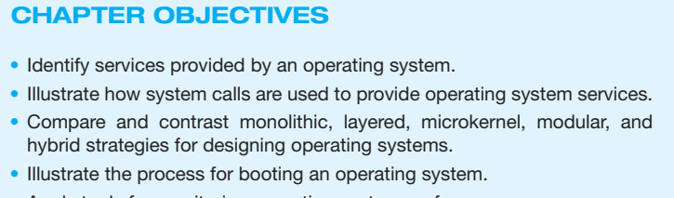

Slide 4
Operating System Services
User interface - Almost all operating systems have a user interface (UI).
Varies between Command-Line (CLI), Graphics User Interface (GUI), Batch
Program execution - The system must be able to load a program into memory and to run that program, end execution, either normally or abnormally (indicating error)
I/O operations - A running program may require I/O, which may involve a file or an I/O device

Slide 5
Operating System Services (Cont’d)
File-system manipulation - The file system is of particular interest. Programs need to read and write files and directories, create and delete them, search them, list file Information, permission management.
Communications – Processes may exchange information, on the same computer or between computers over a network
Communications may be via shared memory or through message passing (packets moved by the OS)
Error detection – OS needs to be constantly aware of possible errors
May occur in the CPU and memory hardware, in I/O devices, in user program
For each type of error, OS should take the appropriate action
Notes:
is the way in which files are named and where they are placed logically for storage and retrieval. Without a file system, stored information wouldn't be isolated into individual files and would be difficult to identify and retrieve. As data capacities increase, the organization and accessibility of individual files are becoming even more important in data storage.

Slide 6
Operating System Services (Cont.)
Resource allocation - When multiple users or multiple jobs running concurrently, resources must be allocated to each of them
Many types of resources - CPU cycles, main memory, file storage, I/O devices.
Logging - To keep track of which programs use how much and what kinds of computer resources
Protection and security - The owners of information stored in a multiuser or networked computer system may want to control use of that information, concurrent processes should not interfere with each other
Protection involves ensuring that all access to system resources is controlled
Security of the system from outsiders requires user authentication, extends to defending external I/O devices from invalid access attempts

Slide 7
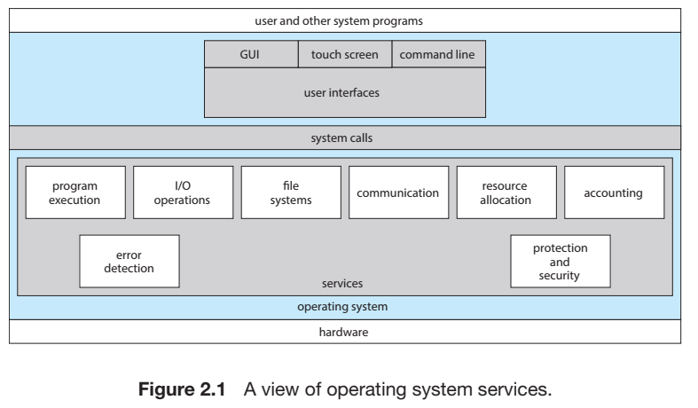

Slide 8
User-Operating System Interaction- CLI
CLI or command interpreter allows direct command entry
Sometimes multiple flavors implemented – shells
Primarily fetches a command from user and executes it
Sometimes commands built-in, sometimes just names of programs
Notes:
An alternative approach—used by UNIX, among other operating systems —implements most commands through system programs. In this case, the command interpreter does not understand the command in any way; it merely uses the command to identify a file to be loaded into memory and executed

Slide 9
User-Operating System Interface - GUI
User-friendly desktop metaphor interface
Usually mouse, keyboard, and monitor
Icons represent files, programs, actions, etc
Various mouse buttons over objects in the interface cause various actions (provide information, options, execute function, open directory (known as a folder)
Many systems now include both CLI and GUI interfaces
Unix and Linux have CLI with optional GUI interfaces (CDE, KDE, GNOME)

Slide 10
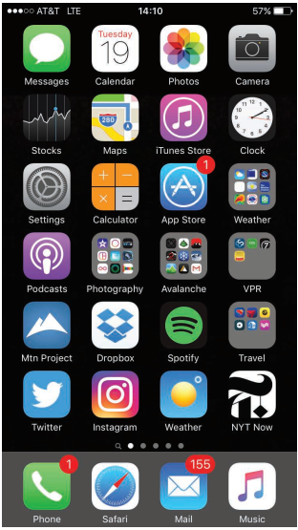
Touchscreen Interfaces
Touchscreen devices require new interfaces
Mouse not possible or not desired
Actions and selection based on gestures
Virtual keyboard for text entry
Voice commands.

Slide 11
System Calls
Programming interface to the services provided by the OS
Typically written in a high-level language (C or C++)
Mostly accessed by programs via a high-level Application Programming Interface (API) rather than direct system call use
Three most common APIs are Win32 API for Windows, POSIX API for POSIX-based systems (including virtually all versions of UNIX, Linux, and Mac OS X), and Java API for the Java virtual machine (JVM)
Notes:
API stands for Application Programming Interface. In the context of APIs, the word Application refers to any software with a distinct function. Interface can be thought of as a contract of service between two applications. This contract defines how the two communicate with each other using requests and responses

Slide 12
Example of System Calls
System call sequence to copy the contents of one file to another file
cp in.txt out.txt

Slide 13
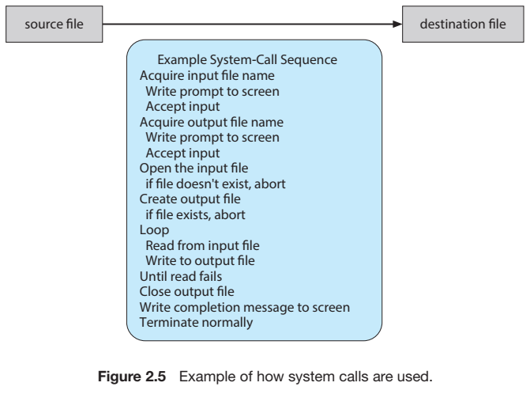

Slide 14
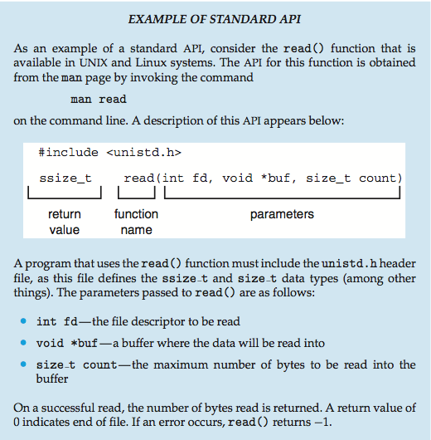
Notes:
The API specifies a set of functions that are available to an application programmer, including the parameters that are passed to each function and the return values the programmer can expect . Even simple programs may make heavy use of the operating system. Frequently, systems execute thousands of system calls per second.
A programmer accesses an API via a library of code provided by the operating system. In the case of UNIX and Linux for programs written in the C language, the library is called libc

Slide 15
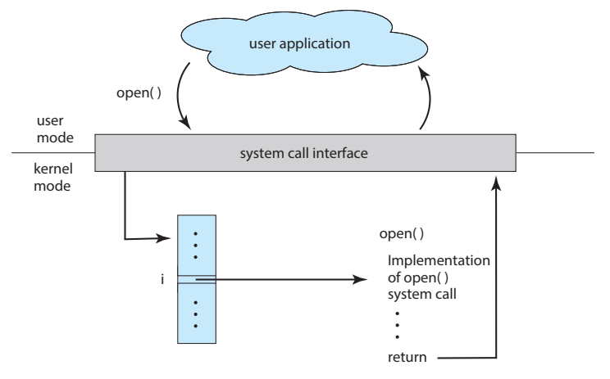
API – System Call – OS Relationship

Slide 16
System Call Parameter Passing
Three general methods used to pass parameters to the OS
Pass the parameters in registers
Parameters stored in a block, or table, in memory, and address of block passed as a parameter in a register
Parameters placed, or pushed, onto the stack by the program and popped off the stack by the operating system

Slide 17
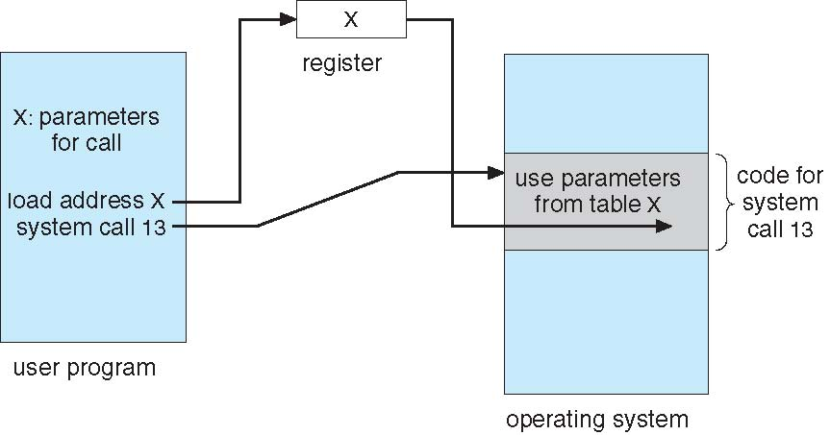
System Call Parameter Passing via Table

Slide 18
Types of System Calls
System calls can be roughly grouped into five major categories:
Process Control
File management
Device Management
Information Maintenance
Communication

Slide 19
Types of System Calls
1. Process Control
load
execute
create process (for example, fork on Unix-like systems)
terminate process
get/set process attributes
wait for time, wait event, signal event
allocate free memory
Notes:
often, two or more processes may share data. To ensure the integrity of the data being shared, operating systems often provide system calls allowing a process to lock shared data Typically, such system calls include acquire lock() and release lock()

Slide 20
Types of System Calls
2.File management
create file, delete file
open, close
read, write, reposition
get/set file attributes
3.Device Management
request device, release device
read, write, reposition
get/set device attributes
logically attach or detach devices

Slide 21
Types of System Calls
4.Information Maintenance
get/set time or date
get/set system data
get/set process, file, or device attributes
5.Communication
create, delete communication connection
send, receive messages
transfer status information
attach or detach remote device

Slide 22
Types of System Calls
6. Protection
get file permissions
set file permissions

Slide 23
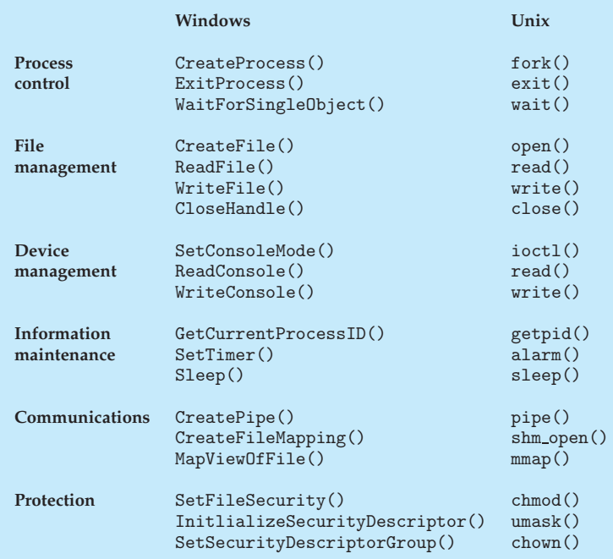

Slide 24
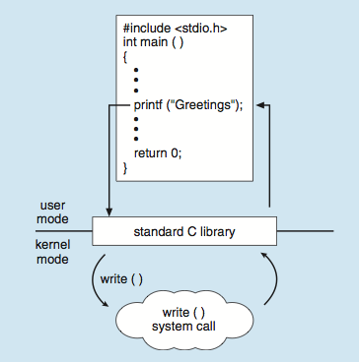
Standard C Library Example
The standard C library provides a portion of the system-call interface for many versions of UNIX and Linux.
C program invoking printf() library call, which calls write() system call

Slide 25
Process Control
There are so many variations in process control that we next use two examples
one involving a single-tasking system
the other a multitasking system

Slide 26
Process Control: Example: Arduino
Single-tasking
Arduino is considered a single-tasking system, as only one sketch can be present in memory at a time
if another sketch is loaded, it replaces the existing sketch.
Furthermore, the Arduino provides no user interface beyond hardware input sensors.
Notes:
To write a program for the Arduino, we first write the program on a PC and then upload the compiled program (known as a sketch) from the PC to the Arduino’s flash memory The standard Arduino platform does not provide an operating system; instead, a small piece of software known as a boot loader loads the sketch into a specific region in the Arduino’s memory

Slide 27
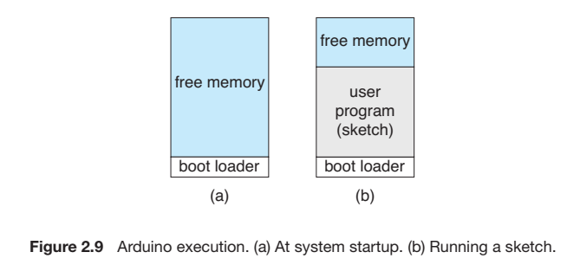

Slide 28
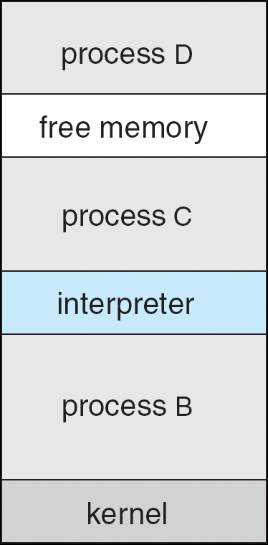
Example: FreeBSD (Unix variant)
Multitasking
User login -> invoke user’s choice of shell
Shell executes fork() system call to create process
Executes exec() to load program into process
Shell waits for process to terminate or continues with user commands
Process exits with:
code = 0 – no error
code > 0 – error code

Slide 29
System Services
System services, also known as system utilities, provide a convenient environment for program development and execution.
They can be divided into:
File Management
Status information: sometimes stored in a Registry
File modification
Programming language support
Program loading and execution
Communications
Background services: launching certain system-program processes at boot time
Application programs
Notes:
Status Information: Some programs simply ask the system for the date, time, amount of available memory or disk space, number of users, or similar status information

Slide 30
System Services (Cont.)
File management - Create, delete, copy, rename, print, dump, list, and generally manipulate files and directories
Status information
Some ask the system for info - date, time, amount of available memory, disk space, number of users
Others provide detailed performance, logging, and debugging information

Slide 31
System Services (Cont.)
File modification
Text editors to create and modify files
Special commands to search contents of files or perform transformations of the text
Programming-language support - Compilers, assemblers, debuggers and interpreters sometimes provided
Program loading and execution- Once a program is assembled or compiled, it must be loaded into memory to be executed
Communications - Provide the mechanism for creating virtual connections among processes, users, and computer systems

Slide 32
System Services (Cont.)
Background Services
Launch at boot time
Provide facilities like disk checking, process scheduling, error logging, printing
Run in user context not kernel context
Known as services, subsystems, daemons
Application programs
Run by users
Linkers and Loaders

Slide 33
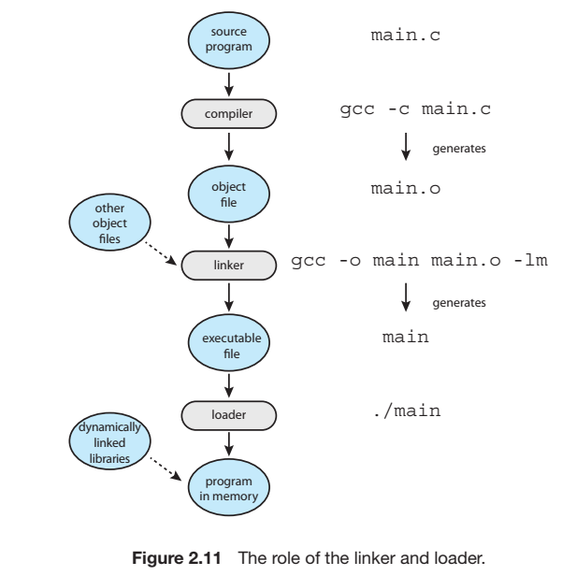

Slide 34
Operating System Design and Implementation
Challenge: Start the design by defining goals and specifications
Affected by choice of hardware, type of system
User goals and System goals
User goals – operating system should be convenient to use, easy to learn, reliable, safe, and fast
System goals – operating system should be easy to design, implement, and maintain, as well as flexible, reliable, error-free, and efficient

Slide 35
Operating System Design and Implementation (Cont.)
Important principle to separate
Policy: What will be done?
Mechanism: How to do it?
Mechanisms determine how to do something, policies decide what will be done
The separation of policy from mechanism is a very important principle, it allows maximum flexibility if policy decisions are to be changed later (example – timer)

Slide 36
Operating System Structure
There are six different structures:
Monolithic Structure
Layered Systems
Micro-kernels
Modules
Hybrid Machines

Slide 37
Operating System Structure
1.Monolithic Structure:
Simplest Structure: No structure at all
place all of the functionality of the kernel into a single, static binary file that runs in a single address space
DOS has no modern software engineering techniques,
Does not break the system into subsystems, and has no distinction between user and kernel modes.
Allow all programs direct access to hardware.
The monolithic approach is often known as a tightly coupled system because changes to one part of the system can have wide-ranging effects on other parts.

Slide 38
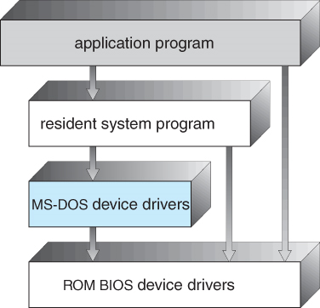
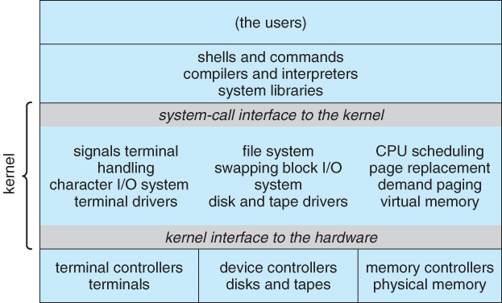
Fig: MS-DOS layer structure
Fig: Traditional UNIX system structure

Slide 39
Operating System Structure
2.Layered Approach:
Another approach is to break the OS into number of smaller layers and relies on the services provided by next lower layer.
a loosely coupled system
Allows each layer to be developed and debugged independently.
With the layered approach, the operating system is broken into a number of layers (levels). The bottom layer (layer 0) is the hardware; the highest (layer N) is the user interface.

Slide 40
Operating System Structure
Layered systems have been successfully used in computer networks (such as TCP/IP) and web applications.
Nevertheless, relatively few operating systems use a pure layered approach because the overall performance of such systems is poor due to the overhead of requiring a user program to traverse through multiple layers to obtain an operating-system service.
Layered approaches can also be less efficient, as a request for service from a higher layer has to filter through all lower layers before it reaches the HW, possibly with significant processing at each step.

Slide 41
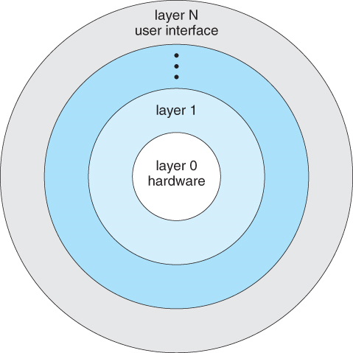

Slide 42
Operating System Structure
3.Microkernels:
micro kernels is to remove all non-essential services from the kernel, and implement them as user-level programs that reside in separate address spaces, resulting in a small kernel.
provide basic process and memory management, and message passing between other services Security and protection can be enhanced, as most services are performed in user mode, not kernel mode.
System expansion can also be easier, because it only involves adding more system applications, not rebuilding a new kernel.
Mach, Windows NT are examples of kernel

Slide 43
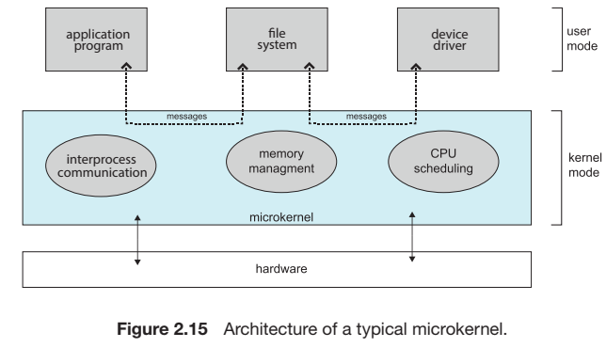

Slide 44
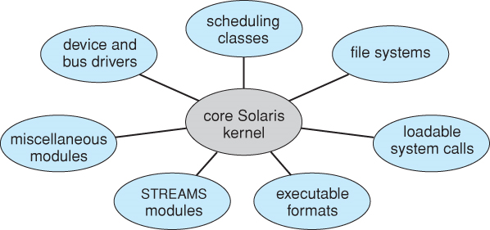
Operating System Structure
4.Modules
Modern OS development is object-oriented, with a loadable kernel modules which can be linked in dynamically.
Modules are similar to layers in that each subsystem has clearly defined tasks and interfaces.
The kernel is relatively small in this architecture, similar to microkernels, but the kernel does not have to implement message passing since modules are free to contact each other directly.

Slide 45
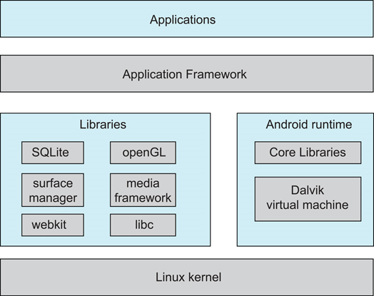
Operating System Structure
5.Hybrid Systems:Most OS today do not strictly
adhere to one architecture, but are hybrids of
several.
Android:
open-source OS
includes versions of Linux
and a JVM
apps are developed using
Java

Slide 46
Operating-System Debugging
Debugging is finding and fixing errors, or bugs
OS generate log files containing error information
Failure of an application can generate core dump file capturing memory of the process
Operating system failure can generate crash dump file containing kernel memory

Slide 47
Operating System Generation
SYSGEN program obtains information concerning the specific configuration of the hardware system
Used to build system-specific compiled kernel or system-tuned
If you are generating (or building) an operating system from scratch, you must follow these steps:
Write the operating system source code (or obtain previously written source code).
Configure the operating system for the system on which it will run.
Compile the operating system.
Install the operating system.
Boot the computer and its new operating system

Slide 48
Download the Linux source code from http://www.kernel.org
Configure the kernel using the “make menuconfig” command. This step generates the .config configuration file.
Compile the main kernel using the “make” command. The make command compiles the kernel based on the configuration parameters identified in the .config file, producing the file vmlinuz, which is the kernel image.
Compile the kernel modules using the “make modules” command. Just as with compiling the kernel, module compilation depends on the configuration parameters specified in the .config file.
Use the command “make modules install” to install the kernel modules into vmlinuz.
Install the new kernel on the system by entering the “make install” command.

